Slide 1
Service Learning @ The American Red Cross
Greg Blackert
Cre-101 Summer II
Gregoryalanblackert.weebly.com

Slide 2
Introduction to the Red Cross
For my Service Learning project I spent my time at the Red Cross in Clinton, IA.
To get a visual of this Red Cross:
Remodeled 4-5 bedroom ranch style home
Unattached 3 car garage for storage
Little parking lot for approx 10 cars
Perfect location for the small town of 30,000 and surrounding towns in Clinton County.
Amber gave me tasks around the office.

Slide 3
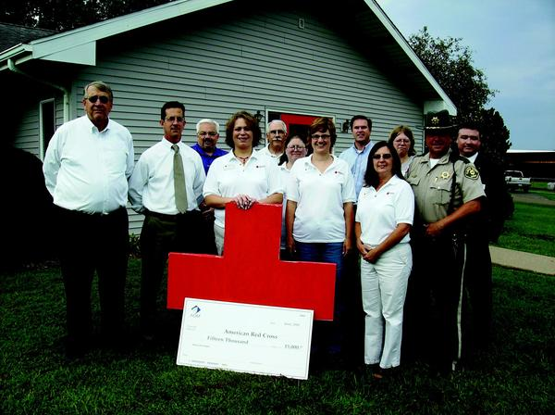
Picture outside the Clinton Red Cross I volunteered at

Slide 4
Goals for my Service Learning
Provide the Red Cross with whatever help I can in the short time.
Gain some knowledge about the Red Cross.
Provide service to Clinton County.
Connect with the community.
Relate my issue with the Red Cross.

Slide 5
My Participation at the Red Cross
I did several stress free tasks including:
Preparing post cards for a blood drive.
Taking inventory on Red Cross bags.
Putting together care bags.
Running errands to Wal-Mart for office necessities.
Placing address labels on babysitting brochures.
Moving cases of bottled water from the garage to the office.
Preparing for the 5K run for the Red Cross.
Volunteering for the 5K run.

Slide 6
How Does the Red Cross Relate to My Issue? Natural Disasters
Immediately, the Red Cross can provide:
Emergency assistance
Disaster relief
Shelter, food, and health service
Each year in America the Red Cross responds to more than 70,000 disasters including:
Hurricanes
Floods
Tornadoes
Earthquakes
*see reference #1

Slide 7
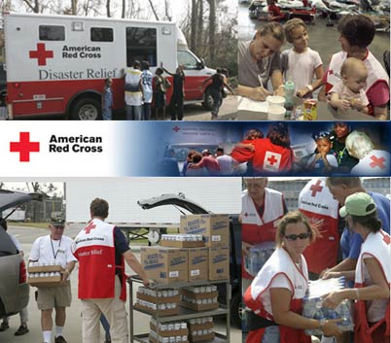
The Red Cross Disaster Relief program

Slide 8
How Does the Clinton, IA Red Cross Relate to My Issue?
Tornado and flood relief
Clinton is on the Mississippi River which has inquired issues with flooding in the past months this year.
Providing shelter arrangements for those effected by the flooding.
Clinton is also in the mid-west region of the America, where tornadoes do occur.
Providing places of safety or alternate shelter when tornadoes hit. Underground locations are mapped in the area. One of the locations is at my college campus.

Slide 9
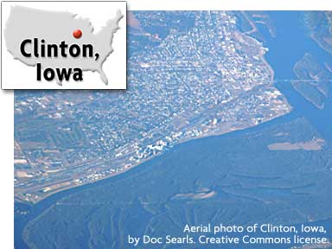
Clinton, Iowa on the Mississippi

Slide 10
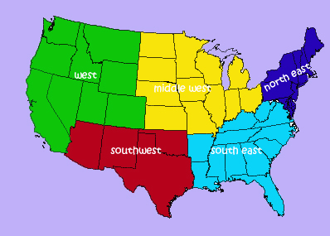
The Poll:
In terms of natural disaster’s, what region of the United States would you think the Red Cross provides the most assistance?
As a result of surveying all participants in Iowa, the totals may be staggered do to general region.
*26 people were surveyed, I made copies of the poll and disbursed them individually.
West-1
Southwest- 1
Midwest- 9
Southeast- 12
Northeast- 3

Slide 11
The Red Cross 5K Run I Volunteered For
Tasks:
Made a Wal-Mart trip for clothes pins.
Prepared participant cards with clothes pins for the more than 200 participants.
Cheered on participants on the last leg.
Connected with the community.
Facts about the run:
3.2 mile run (5K)
DeWitt, IA
People of all ages ran and walked.
The fastest participant finished in just over 17 minutes, which is an extremely fast pace, under 6 minutes per mile.

Slide 12
Conclusion of Service Project
After spending time volunteering at the Red Cross, I can now say that I have given service to the community of Clinton. While doing so I gained a better understanding of the importance of the Red Cross and their role regarding the issue of natural disasters. I also accomplished my goal of connecting with the community, by participating in the 5K run event. I thank Amber for giving me the opportunity to volunteer, as well as Phyllis Salsedo for requiring me do service learning.

Slide 13
Reference Page
http://en.wikipedia.org/wiki/American_Red_Cross

